Slide 1
The Role of the Rehabilitation Officer Visual Impairment
(ROVI)
Kathryn Greenwood
Senior Practitioner, Bridgend Community Independence and Wellbeing Team

Slide 2
Overview
Setting the scene
What is a ROVI?
Fitting into the Bigger Picture
Take Away Messages

Slide 3
A few of my favourite things…
Reading my children a story
Flirting with a stranger
Nipping into the supermarket to get milk
Trying out a new recipe
Putting on a bit of make up
Telling my wife / partner they look nice
Putting up shelves
Enjoying an exhibition or going to a show or the cinema
Notes:
Not life or death examples, not related to jobs or money or bills but enrich life, part of everyday living, fill our days, give us pleasure
How would you feel if you couldn’t do these things? How would you manage?
Vision loss affects all areas of a person’s life – easy to forget the stuff that we all take for granted but all impacts in some form or other

Slide 4
Role of Rehabilitation Officer Visual Impairment (ROVI)
Who we work with:
Adults and children of all ages (including those with additional disabilities and complex needs)
What we do:
Build confidence (provide emotional support)
Regain lost skills and teach new skills
Maintain and promote independence and choice

Slide 5
Role
Specialist Skills Areas:
Mobility
Communication
Independent Living Skills
Emotional/Psychological Support
Information and Advice (including info
on eye conditions)
Notes:
Physical Illness is one of the main causes of depression…visual impairment is a physical illness (although not always perceived as so by the service user or by services or by the general public…can’t see vision loss, whereas can see the wheelchair or the walking sticks)
(Dr Daniel Smith Wales and West Vision Conference 2009)
Studies have shown that people with visual impairment 33% more likely to be affected by depression (Evans et al 2007, Brody et al 2001, Rovner et al 2002)

Slide 6
Role
This is achieved by:
Formulating and following a person-centred, individual Rehabilitation Programme
Teaching alternative and safe methods of carrying out everyday tasks (including those involving risk)
Empowering, enabling and supporting people to re-establish new goals
Assessment for equipment and adaptations
Notes:
Diversity of Role – bump ons to Trekker Breeze (voice activated GPS system) to Contact Sessions with a visually impaired new mum

Slide 7
Case examples
1. Teaching a totally blind 17 year old (who had previously only walked across to her Nan’s on her own) the route from Bridgend to Royal College of Music and Drama in Cardiff. Via trains and taxi’s and long cane training.
2. Improving general lighting and provision of task lighting and magnification (through low vision assessment) to enable an older person to continue sewing because ‘sewing is my life’.
3. Teaching a Job Centre Plus employee the route from home to work. Providing VI awareness training for his colleagues.
4. Teaching an older person living on their own to safely make a cup of tea and prepare a microwave meal.
5. VI awareness sessions in site portacabins with building contractors working on major town centre alterations
6. Scones and i pads
Notes:
Diversity of caseload / interventions / requests
Weekly sessions over a 6 month period– planning – booking sighted assistance at train station, cash desk at station, taxi journey, handling money, contingency planning – what if she doesn’t get off at the correct stop.
Client purchased 5 more daylight bulbs and had them installed throughout house.

Slide 8
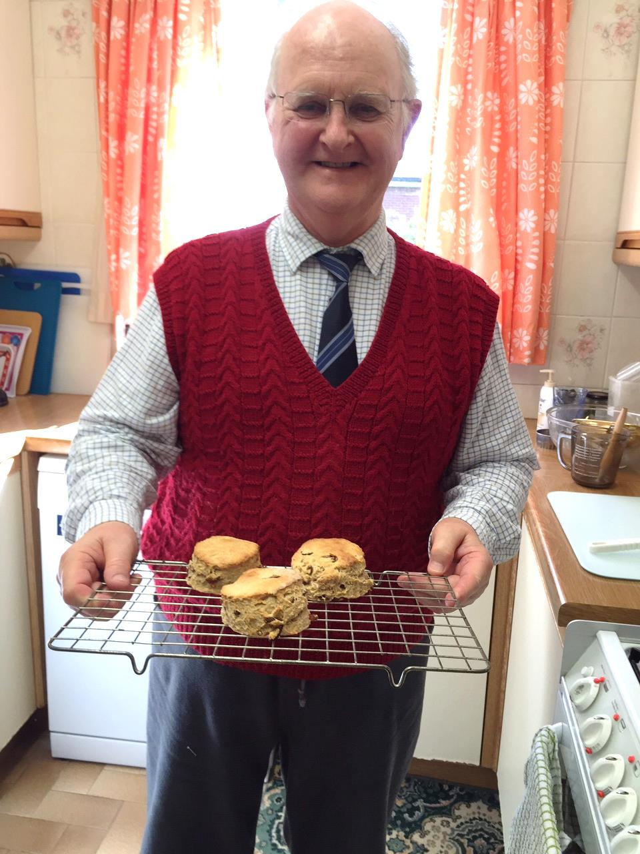
Notes:
Michael worked as a music teacher, now main carer for his wife. Is registered blind due to glaucoma (previous trabeculectomy and cataract removal). Total loss of visual fields. Acuities R 6/18 L 6/24 tog 6/18
Was first visited by ROVI to complete Blind registration.
ROVI prioritised mobility training as he needed to get out to walk the dog safely – couldn’t see steps, kerbs.
Then did 4 cooking sessions to build confidence, last one was baking scones. The enjoyment he got from cooking was so evident and he was so proud of baking scones.
Good example of tactile marking – notice the dials on cooker!

Slide 9
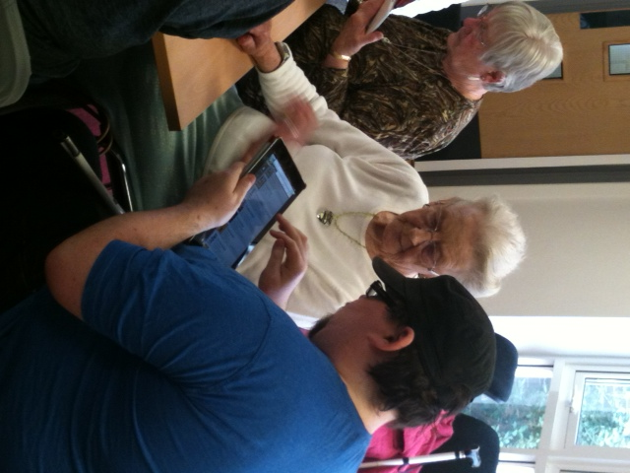
Notes:
Recent IT session focussing on using ipads and iphones.

Slide 10
From: Part 2 Code of Practice on General Functions, Social Services and Wellbeing (Wales) Act 2014
155. Reablement (Rehabilitation) is about helping people to do things for themselves (in contrast to the traditional service models in which the carer does everything) to maximise their ability to live life as independently as possible. It is an outcome-focused, personalised approach whereby the person using the service sets their own goals and is supported by a reablement (rehabilitation) team to achieve them over a limited period. It supports a person’s physical, social and emotional needs and aims to reduce or minimise the need for ongoing support after reablement (rehabilitation). Reablement (Rehabilitation) seeks to improve the skills and resilience of an individual in their specific situation.
Notes:
Perfect summary of the Rehabilitation Role

Slide 11
An Example of The Bigger Picture: Falls Prevention
In March 2002, the National Collaborating Centre for Nursing and Supportive Care (NCC-NSC) was commissioned by NICE to develop clinical guidelines on the assessment and prevention of falls in older people for use in the NHS in England and Wales.
NICE clinical guideline 161 Falls: Assessment and prevention of falls in older people
Notes:
…visual impairment added in 2013…
…cannot work in silos anymore…

Slide 12
Why ROVIs are involved in Falls Prevention?
Vision is key to co-ordinate and plan movement and keep gait, balance and stability
40-50% of people with sight loss limit their activities due to fear of falling
(Buckley et al 2005, 2010 / Wang 2002 / Davis & Davis 2009)
Notes:
Information from Thomas Pocklington Trust / RNIB

Slide 13
Person with sight loss is 90% more likely to have multiple falls than someone without sight loss
Older people with sight loss are twice as likely to get an injury from falls and twice as likely to get hip fracture
(Legood,Scuffham & Cryer 2002)
RNIB estimate that:
the cost to the NHS of falls associated with visual impairment is at least £25.1 million per annum.

Slide 14
How does Rehabilitation Make a Difference to Falls?
Practical interventions
Advice and information
Bridgend
Further reading:
Deteriorating Vision, Falls and Older People: The Links, Visibility (2005)
The Importance of Vision in Preventing Falls, British Geriatrics Society and the College of Optometrists (2010)
Housing for People with Sight Loss: A practical guide to improving existing homes, Thomas Pocklington Trust (2009)
Notes:
Lighting - even / adequate throughout house esp. halls, stairs, kitchen and bathroom
Glare – lampshades, vertical blinds
Contrast – bright colours, highlighting edges of outdoor steps, contrasting handrails
Ensure pathways are clutter free
Advice / info – specs, optoms, lva’s
Bridgend – active/based role with Reablement Teams, ABMU Awareness Training includes Sensory Loss, early and joint interventions, preventative working

Slide 15
Take Away Messages
Early Intervention, Prevention (Social Services and Wellbeing (Wales)Act 2014)
Integrated Working, Co-production (It’s all about the individual and who else can work with us to empower them)
Think Scones and iPads!
Visit the Rehabilitation Stand for local contacts and more information
Notes:
personal practice shows that early intervention makes for more effective rehabilitation. These are all messages in the new Act. Yes vision loss is debilitating and affects all areas of a person’s life ( think about the first exercise about favourite things) but hopefully have also shown that rehabilitation does have positive results
Again related to the new Act working together with other professionals – not in silo’s, pharmacy technician, physios, OTs.
The pictures show it all!
More info about your local area – if no Rehab Service available should be querying with the local managers

Slide 16
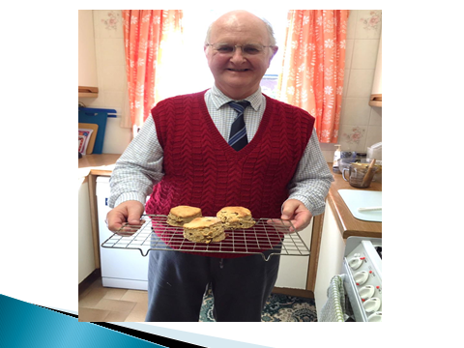
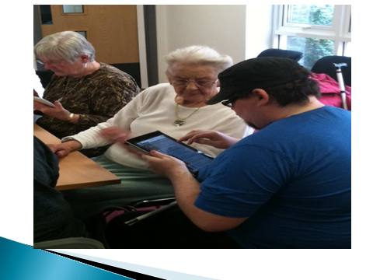
Thank You!

