Slide 1
Future Developments in IT
Fiona Jenkins Chair Wales Eye Care Steering Board
Lisa Gerson Chair Optometry Wales

Slide 2
The Together for Health: Eye Health Care Delivery Plan for Wales 2013-2020
One of its 10 priorities to develop and implement an Electronic Patient record for Eye care
This is needed to improve quality of patient care, enabling more patients to be treated in community optometry practices which in turn will also support the capacity needed to deliver the planned care elements of eye care.

Slide 3
Background
Enables images of eyes to be reviewed over time to track pathology and guide/record treatment.
If linked to community optometry e-referrals can be enabled and care can be shared safely with community optometrists
Eye Health Examination Wales optometrists could provide much more with a true shared clinical record.
This would significant help add capacity into the planned care system, making it more resilient.

Slide 4
Assessment
The National Eye Care Delivery Group, tasked its IT sub group to develop an Outline Business Case for Ophthalmology. It is one business case, in two phases,
justifying the rationale to invest in an e-referral (Workstream 1)
electronic patient record (Workstream 2) solution
National programme hosted by Cardiff & Vale University Health Board on behalf of NHS Wales local health boards working with NHS Wales Informatics Service

Slide 5
Recommendation
An Outline Business Case has identified the combination of E optometry referral and an Electronic patient record, this will enable the primary care services to provide much needed capacity into the planned care system, and modernise clinical practice in hospital eye services, providing appropriate care closer to home, as well as adopting prudent workforce principles.

Slide 6
Progress
The Outline Business Case was approved and a steering group and procurement group established.
Developing regional working ( 3 regions)
Procurement underway
suppliers shortlisted
Full business case will be completed when preferred supplier identified….soon!
E-optometry will be the first element to be rolled out across Wales

Slide 7
The Electronic Patient Record What it means for us!
Optometry Wales, Lisa Gerson, Chair

Slide 8
Who we are?
Optometry Wales, a membership organisation representing all optometric practices, dispensing opticians and optometrists across Wales
700 plus optometrists
450 practices

Slide 9
What we do?
Primary care based eye care – General Ophthalmic Services (GOS), Eye Health Examination Wales (EHEW) and Low Vision Services (LVSW)
Anything else goes to secondary care but we don’t know what happens to our patient when they go into secondary care

Slide 10
The EPR Benefits
No more paper or fax referrals from primary to secondary care
A mechanism to allow ‘shared care’ – access to what happened to Mrs Jones
Increased Efficiency and Workflow
Remote professional oversight
Audit
Instant reassurance for the patient about their journey in eye care
Better communication between all of us!
Supporting the Welsh Government agenda for moving work into primary care
Notes:
A more efficient and timely e-referral solution from community optometrists to Hospital Ophthalmology Services and integration “seamlessly into the Welsh Admin Register (WAP), Patient Administrative Systems and the Welsh Clinical Portal.
A mechanism to allow multidisciplinary-shared care to be extended throughout Eye Care Services in NHS Wales via the provision of an integrated electronic eye care health record to all professionals involved in the patient pathway.
Increase efficiency and workflows:
Low Risk Eye Pathology being “moved” from the Acute Sector into Primary Care.
Enabling performance and enhancing quality and timeliness of care
Consultants in the Acute Sector to under “virtual clinics” to support the “shared care” of the “low risk” Eye Pathology patients “moved” into Primary Care
Integrated remote professional oversight, governance, care and delivery
Data reporting (e.g. eye outcome focused measures, local and national targets/reports)
A robust solution that is interoperable with local and national systems

Slide 11
But..What Else is Happening Digitally in Eye Care?
Update from Ophthalmology Wales

Slide 12
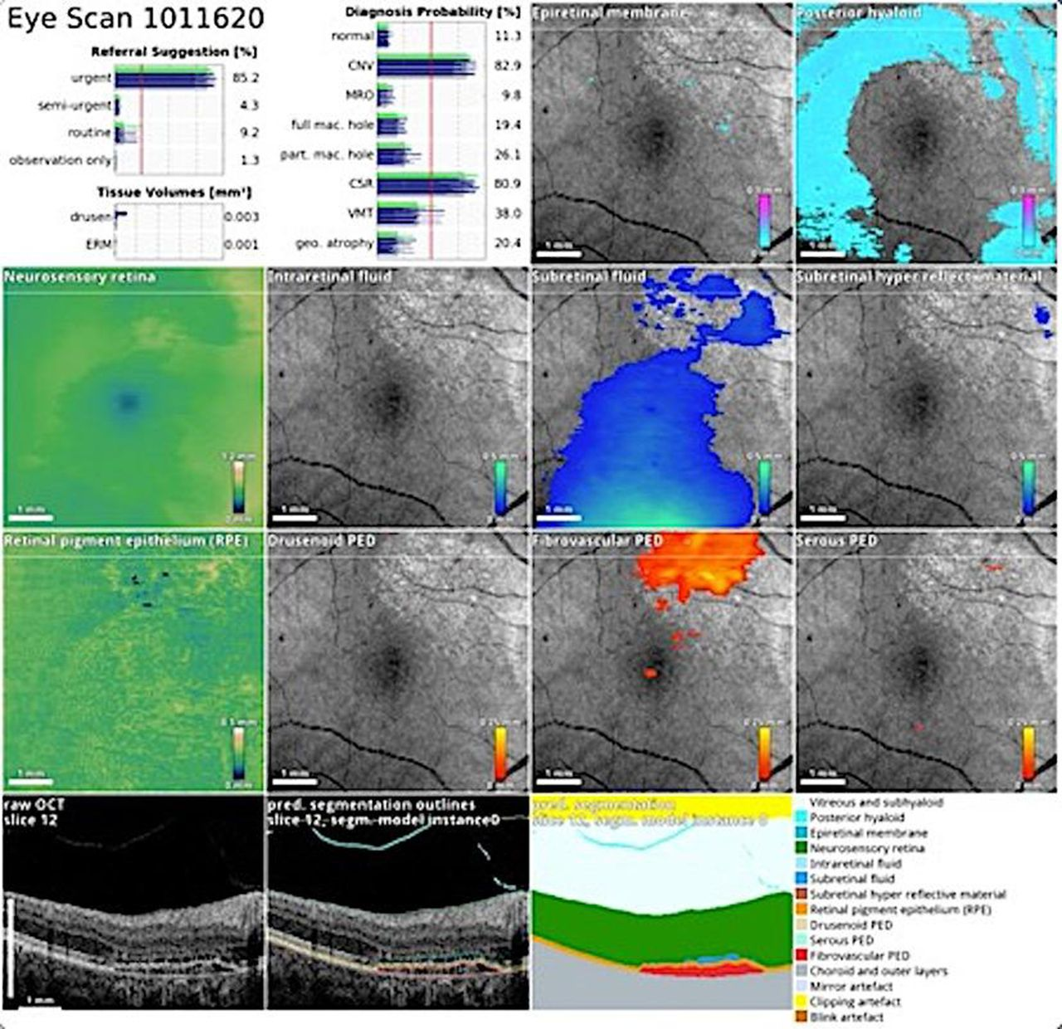
Technological innovation…the future promise
Artificial intelligence (AI)- deep learning: AMD, glaucoma, Diabetic R
Elze et al 2015
Ting et al. 2019
Notes:
Deep learning can identify VF types(left hand image, Elze et al) - unsupervised and can detect OCT changes associated with age related macular degeneration or other considerations- for example Central Serous Retinopathy.

Slide 13
Technological innovation: small steps
We need to walk before we can run…
We need the basics- an EPR to answer basic questions
How many patients?
What diagnoses?
Identify those who need rapid intervention among the thousands who may not
Who is lost to follow up?
Do not use CVI as a measure of success- but the change in vision
We need this information in ‘real time’ not as a sporadic audit
Notes:
Before we get to AI we need to be able to deal with the basics- ask yourself the question- how many patients do I look after, what is the diagnostic distribution and how many are losing vision. These questions can be answered with systematic application of an EPR that covers primary and secondary care. We need to remind ourselves that CVI rates are not a measure of success- they are part of patient management- we need to know the change in vision as our outcome measurement and do this in real time.
We need to move away from audit and use modern BI tools

Slide 14
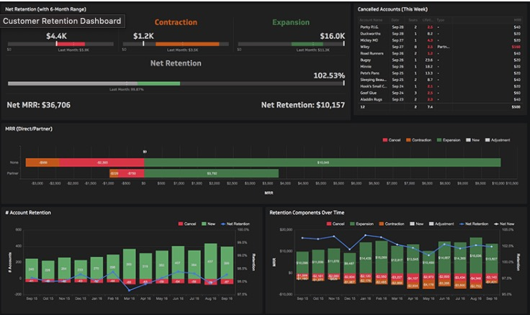
Business intelligence (BI)
Replace audit with BI
Detect problems when they happen (not a year later)
NOD- real-time (not annual)
Infection
Sight loss
Notes:
As with any modern business we need to respond in real time- the NHS is behind the times in monitoring activity- and more importantly- outcomes- good or bad.

Slide 15
The Future is Digital
And we have plans!

