Slide 1



Celebrating 70 years of the NHS
Together for Health Eye Care Delivery Plan
Dr Fiona Jenkins
Chair National Eye Health Care Steering Board

Slide 2


Eye Health Care Plan
Notes:
I am aware that having an Eye Care Plan and a cohesive sector has meant the profile of eye health in Wales has increased. But more importantly, a lot of improvments have been made.
I am aware that having an Eye Care Plan and a cohesive sector has meant the profile of eye health in Wales has increased. But more importantly, a lot of improvments have been made.

Slide 3
PRIORITY 1
Work with Public Health Wales to develop a plan to raise awareness of eye health and the need for regular sight tests to detect and prevent sight loss especially for groups of people at high risk of eye disease.

Slide 4
PRIORITY 2
Deliver quality assured vision screening service to children in mainstream schools on school entry and a service that provides an annual sight test to children with special educational needs in schools.

Slide 5
PRIORITY 3
Work with key partners and primary care clusters to ensure good quality eye care is provided to frail older people, those with dementia and to people in care homes and residential care.

Slide 6
PRIORITY 4
Ensure all optometrists practising in Wales are providing the enhanced Eye Health Examination Wales service to enable more people to be managed closer to home.

Slide 7
PRIORITY 5
Work with Medical Directors and patients to revise targets for ophthalmology services in hospitals to incorporate measures for all patients (new and follow-up) based on clinical need and risk of irreversible sight loss.

Slide 8
PRIORITY 6
Support integrated, efficient working and improve the safe communication of information by rolling out electronic optometry referrals and their prioritisation in hospitals across Wales.

Slide 9
PRIORITY 7
Implement the priority actions of the Wales Ophthalmic Planned Care Plan including the National Cataract Audit.

Slide 10
PRIORITY 8
Develop workforce plans and identify
training needs to support good standards
of care and ensure education and training
is available to support developments in
eye care nationally across Wales; develop
multi-disciplinary teams and care closer to
people’s homes

Slide 11
PRIORITY 9
Work to ensure that everyone entitled is offered certification as sight impaired.

Slide 12
PRIORITY 10
Work with local authorities and Regional
Partnership Boards to support the implementation of the Social Services and Well-being (Wales) Act 2014 with regard to sight impairment; key to this is the provision of rehabilitation and habilitation services in every authority to prevent loss of independence, loss of mobility, falls, isolation and depression in people with sight loss/vision impairment.

Slide 13

What Next?
Ensure progress with the key actions

Slide 14


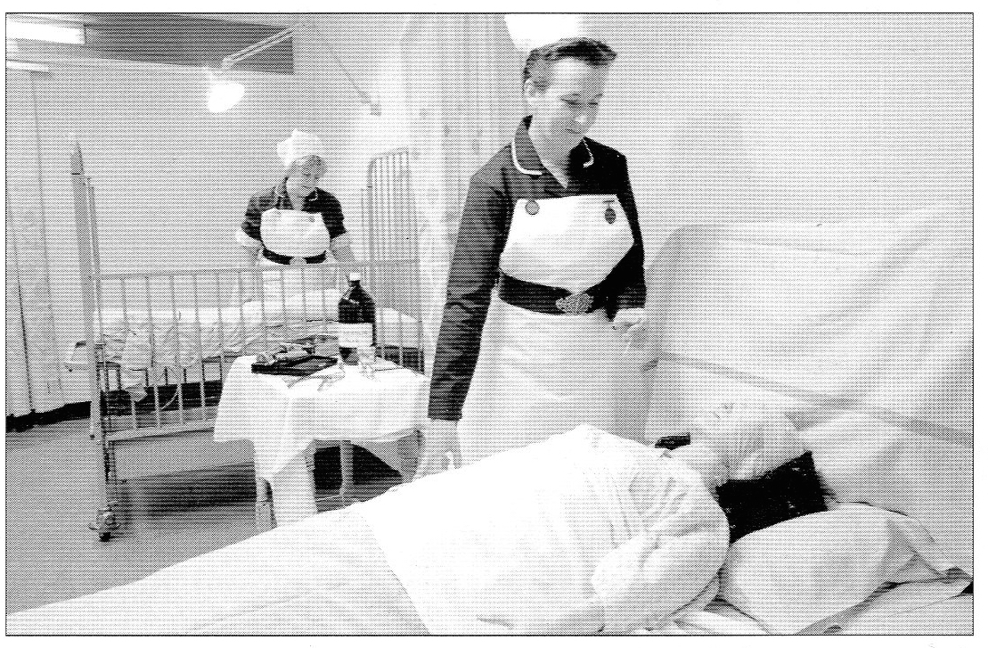
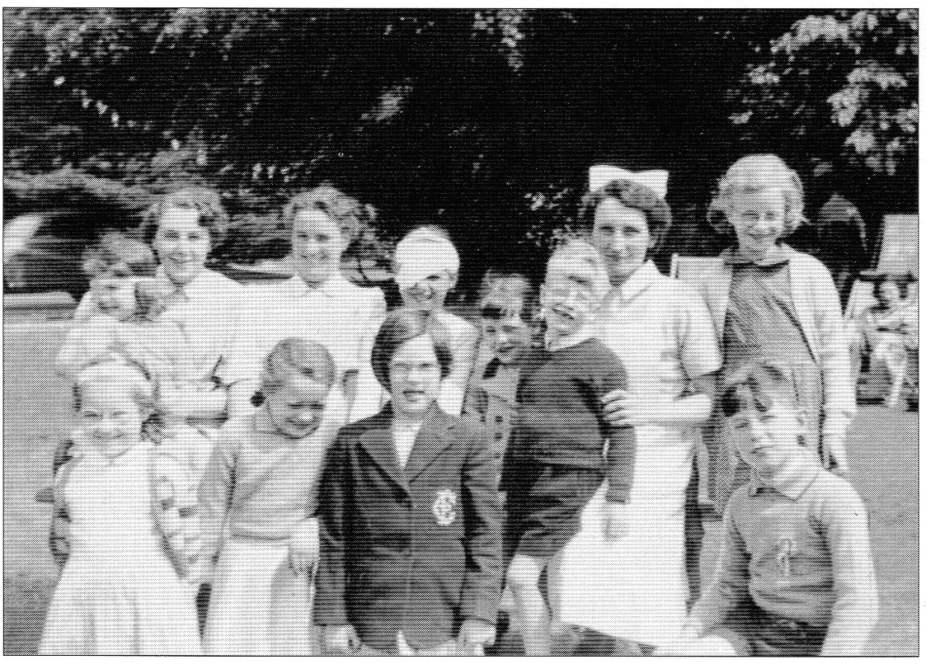
2018
Celebrating 70 years of the NHS in Wales

