Slide 1
All Wales Standards for Accessible Communication and Information for People with Sensory Loss

Slide 2
Sensory Loss Population in Wales in Wales
More than 600, 000 people in Wales have hearing and/or sight loss
115, 000 people in Wales are estimated to be living with sight loss that has a significant impact on their daily lives
575,000 deaf or hard of hearing people in Wales
4,000 people who are Deaf and use British Sign Language (BSL)

Slide 3
Communication and Information Barriers
Missed appointments
Medical advice not being sought when needed
Late diagnosis and less effective treatment
Not understanding diagnosis or how to take
medication
Poor patient experience and poorer health
outcomes
.

Slide 4
All Wales Standards – 3 Key Priorities
Recording and flagging patients’ communication and information needs across primary and secondary healthcare
Developing staff awareness and workforce engagement
Accessible appointment systems that enable patients to communicate in a variety of ways including using texts and emails

Slide 5
Sensory Loss Information Standard
Purpose
Implementation
Benefits to patients and service users
Next Steps

Slide 6
Communication and Engagement Plan
To raise general awareness of the Standard
with general practices and members of the
Sensory Loss Community
October 2017 – March 2018

Slide 7
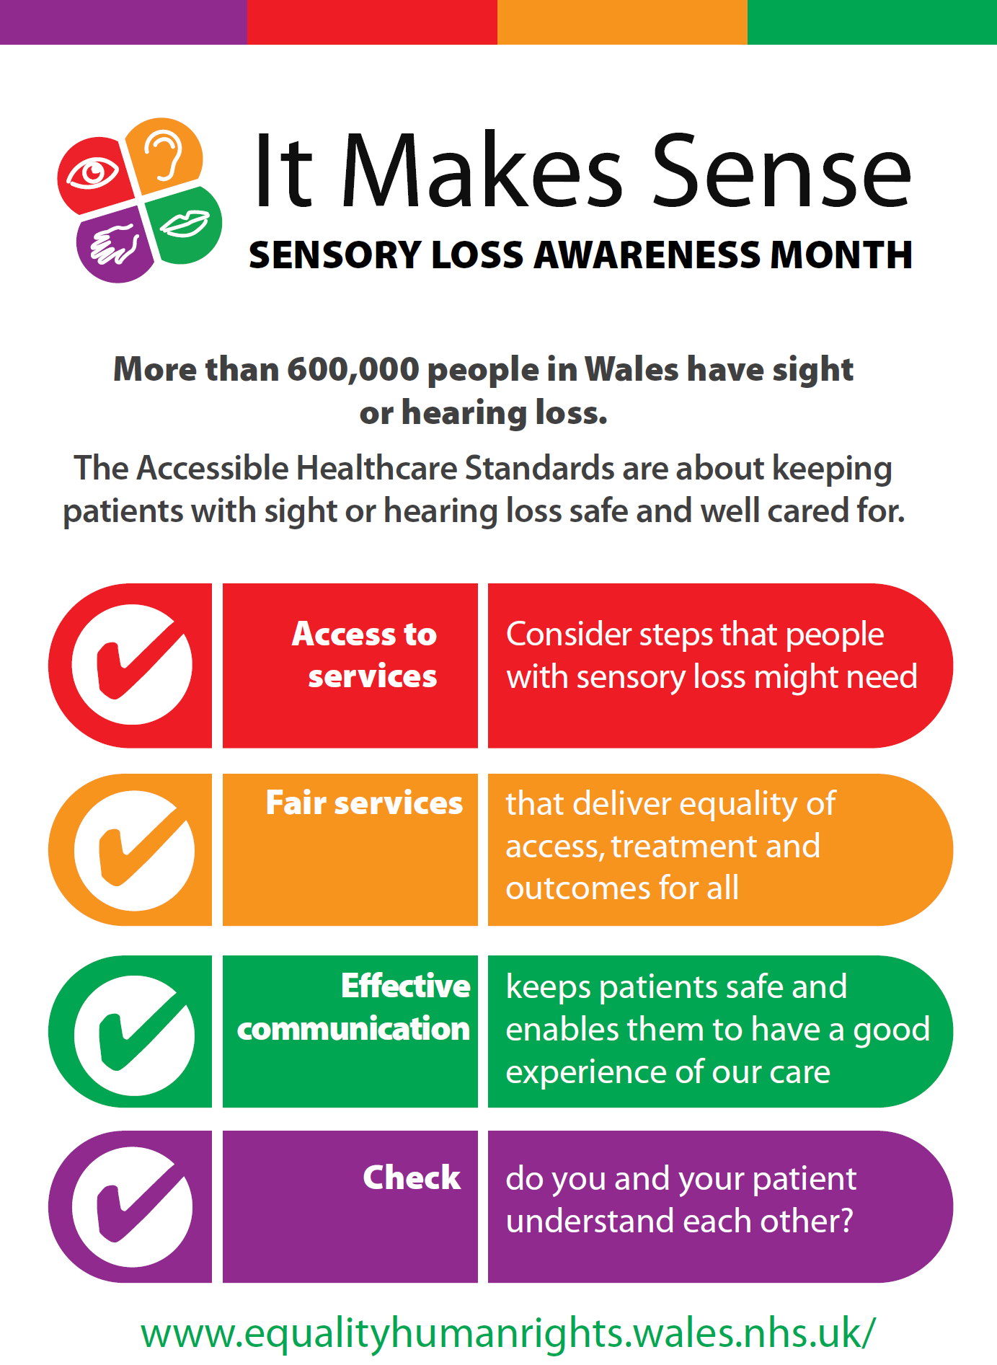

Slide 8
Public Campaign Messages
Tell doctors, nurses, paramedics and other health professionals how you prefer to communicate.
Ask to receive information in the format you prefer, including British Sign Language, large print, electronic or braille.
Share your concerns if you do not receive this.

Slide 9
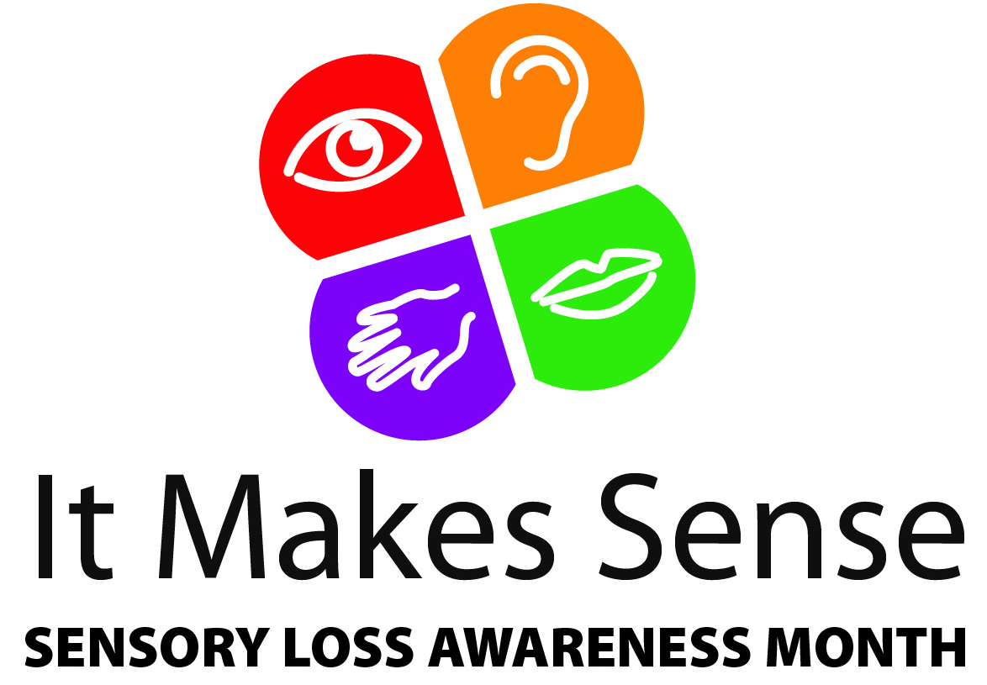
‘It Makes Sense’ Sensory Loss Awareness Month 2017
National Launch
Thursday 23rd November 2017
Port Talbot Resource Centre
2.00 pm – 3.00 pm

