Slide 1
Delivering Eye Care Closer to Home
Craige Wilson
Assistant Director of Operations

Slide 2
Background
Three projects approved by Welsh Government
Cyclo-refraction for paediatrics
Post operative cataract examination
Glaucoma assessment
Funding available for 3 months commencing 2nd January 2015

Slide 3
Participation
25 of 28 optometry practices in Cwm Taf took part in 1 or more of the schemes
Cyclo-refractions for paediatrics
80 patients sent invitations
64 seen in practices
16 not responded

Slide 4
Participation
Post Op Cataract examination
66 patients accessed scheme
33 had follow in hospital
21 referred to community service
Glaucoma Assessment
999 patients identified for scheme
13 patients refused
764 assessment forms returned

Slide 5
Patient Experience
59% of patients completed an evaluation form
Approximately 400 forms completed

Slide 6
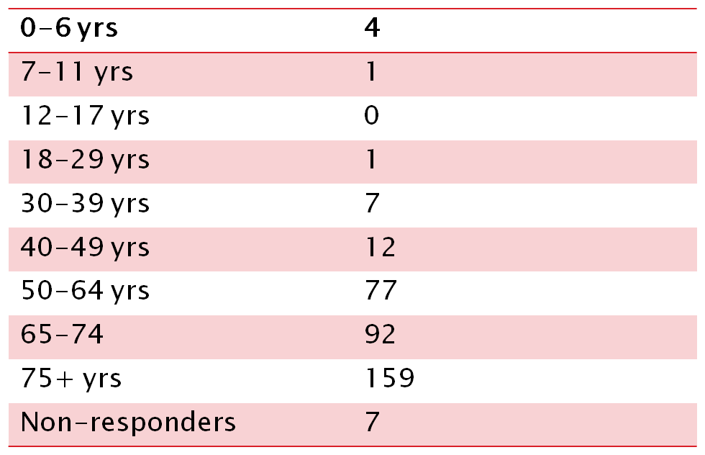
Patient Age Range

Slide 7
Presenting Condition
Glaucoma | 295
OHT | 96
Cataract | 20
Other | 15
Non-Responders | 10
** some patients ticked more than one box as they had more than one condition

Slide 8
Length of time since last Hospital appointment
< 6 months | 16
6-11 months | 69
12-23 months | 167
>24 months | 43
Not answered | 65

Slide 9
Hospital Postponed Appointments
37.7% had at least 1 appointment postponed
57.8% had not had any appointments postponed
14.5% did not answer the question

Slide 10
Visit to Optometrist
Patients spent between 20-135 minutes at the Practice with the Optometrist
86.9% of patients felt that the time spent at the Practice was either shorter than expected or what they expected
96.4% of patients felt they had sufficient time with the Optometrist

Slide 11
Is it important to see a Doctor rather than an Optometrist?
110 patients (30.6%) felt it was either very important or quite important to be seen by a Doctor.
245 (68.1%) did not feel it important to be seen by a doctor rather than an Optometrist.

Slide 12
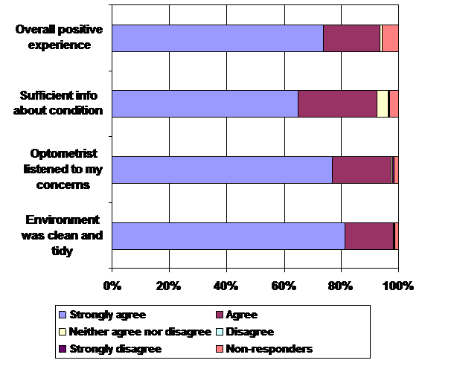
Visit to Optometrist

Slide 13
Feedback and Comments from Patients
Very pleased with my appointment, very friendly and helpful staff who fully explained each procedure, which gave re-assurance.
Much better experience than a hospital appointment. Thank you!
Easier and more convenient than going to the hospital. Getting the field vision test better than having two hospital appointments.
Easier to attend. Am confident that my optician will pick up any problems and refer back to hospital if necessary.
There was a shorter waiting time to be seen. Prefer to visit here again instead of Out-patients

Slide 14
What next?
Cyclo-refraction – would like to build the option of a community assessment into the referral pathway
Continued with the post operative cataract system – but must improve take up
Potential for 1,000 plus more patients to access the glaucoma assessment scheme – but need to improve selection of patients

Slide 15
Any Questions ?

